Slide 1


SQL Project
Group 3
Celine Tsai, Nivedita Thapa, Jessica Yuan, Barry Shen, Shruti Garg
Fall 2020

Slide 2
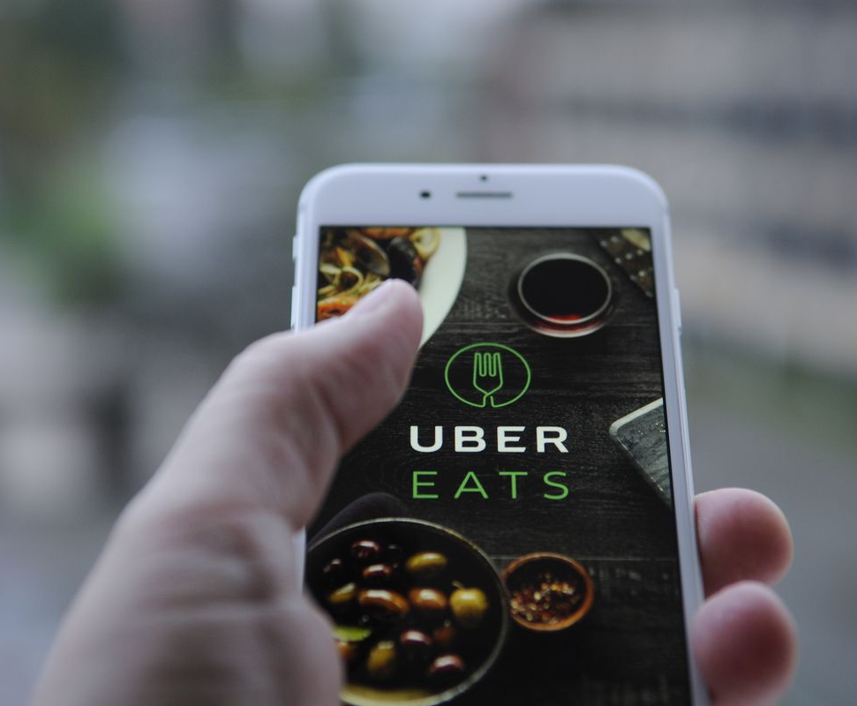

AGENDA
Business Scenario
Diagrams and Tables
SQL Queries
Visualization
Advanced SQL Queries
Conclusion

Slide 3
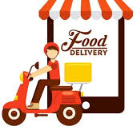
Business Scenario
Christina orders tofu soup and seafood pancakes from the restaurant Tofu Plus at 5:30pm via the UberEats app. She makes her order, enters her home address and mobile number, credit card information, and additional notes for the restaurant and the driver at time of delivery. At 5:35pm, she receives a text that her food is being prepared from the restaurant. At 6:00pm, Christina receives another text from the restaurant stating that her food is ready and is being picked up by Fred, the Uber Eats driver. If the restaurant didn’t respond to Christina’s order for up to 10 mins, Christina’s order will be canceled automatically and get a refund.
Fred indicates via the app that he has picked up Christina’s order and is making his way to his destination. He chooses his destination and the navigation starts. As Fred is driving, Christina can track the location of the driver via the UberEats app. The app also shows the ETA of her driver. When the driver is near Christina’s neighborhood, she receives a notification from the UberEats app that the driver is nearby. The driver drops her food at Christina's front door and she receives another notification that her food has arrived. Christina picks up her food and she receives another notification asking for her experience with today’s food delivery service.
Notes:
Celine Tsai

Slide 4
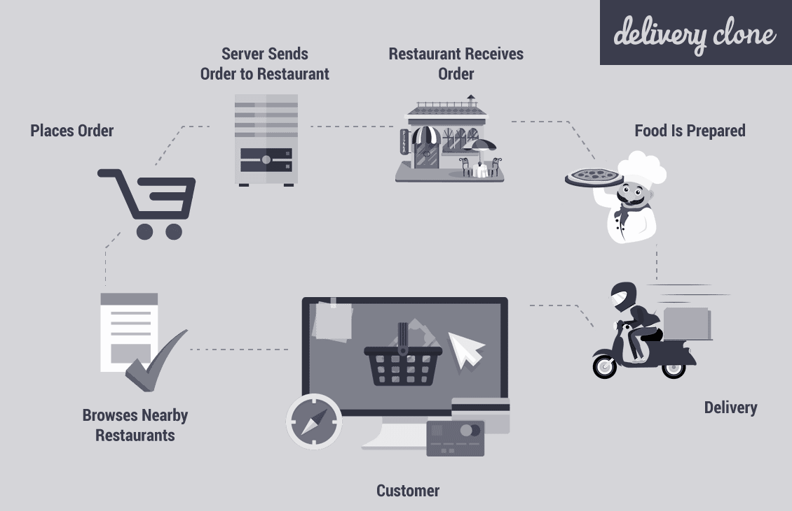
Online Food Order Process
Notes:
Celine

Slide 5
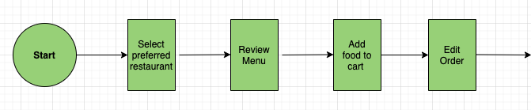
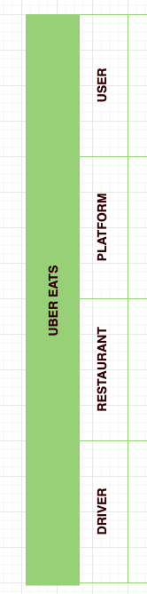
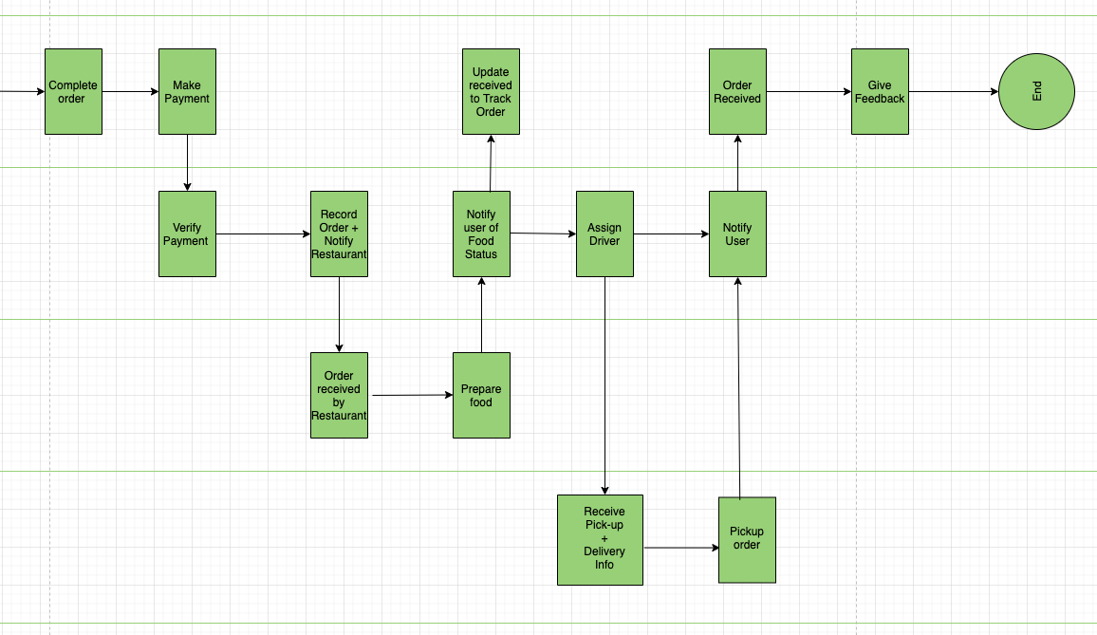
Swim Lane Diagram
Notes:
Celine

Slide 6







Tables
RESTAURANT
FOOD
ORDER
PAYMENTS
CUSTOMER
DRIVER
FEEDBACK
Notes:
Nivedita Thapa

Slide 7
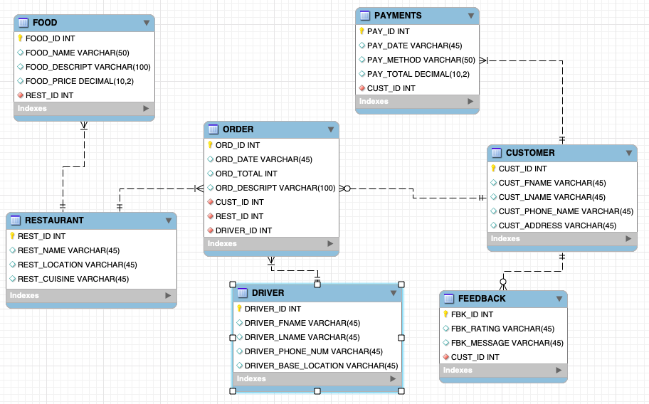
Entity Relationship Diagram

Slide 8
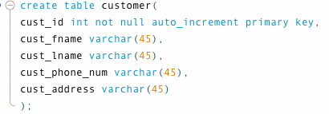
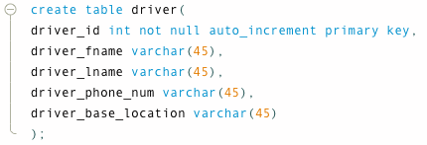
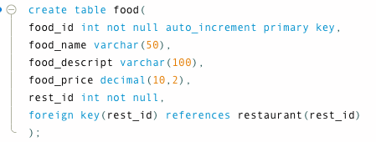
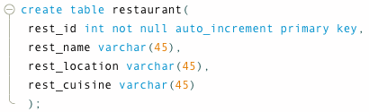
Table Creation

Slide 9
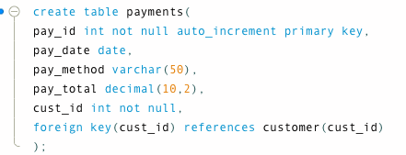
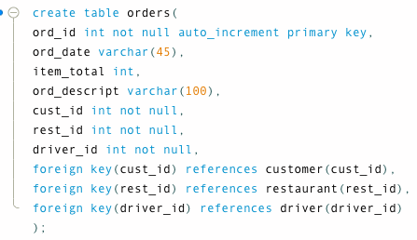
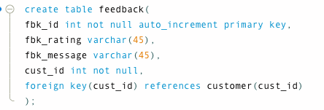
Table Creation (conti.)

Slide 10
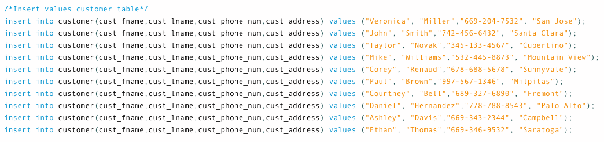
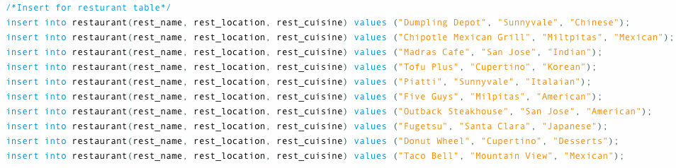

Slide 11
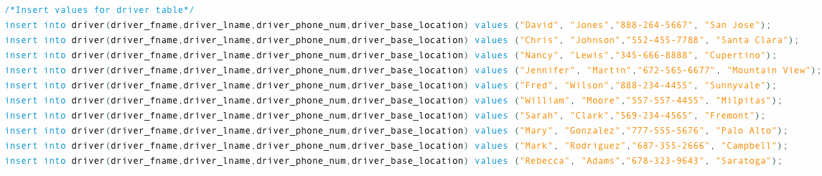
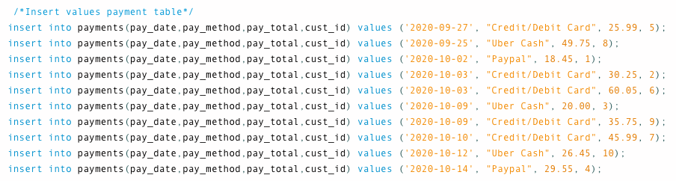

Slide 12
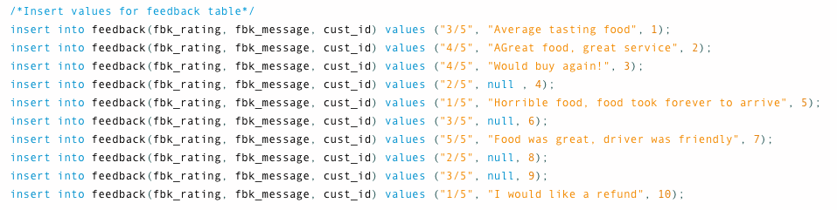

Slide 13
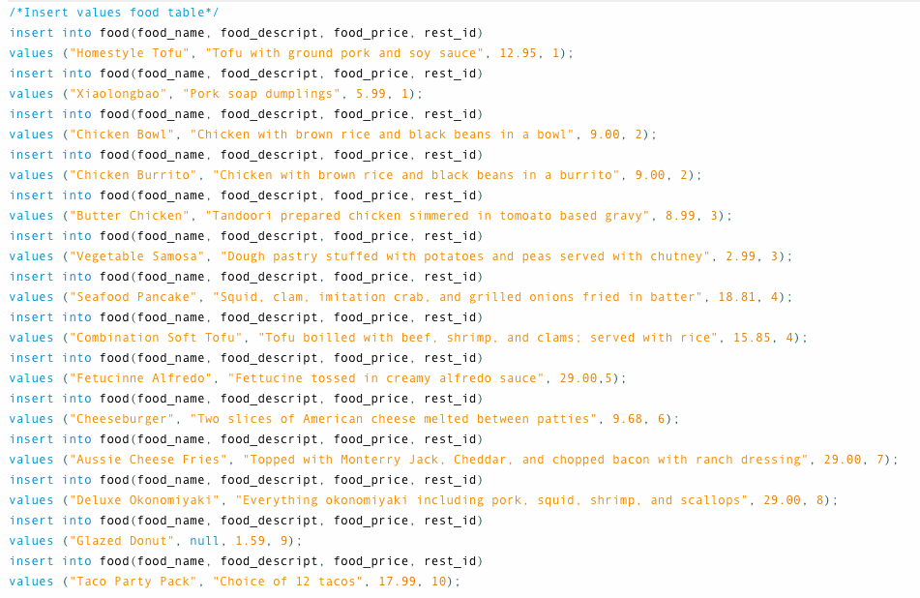

Slide 14
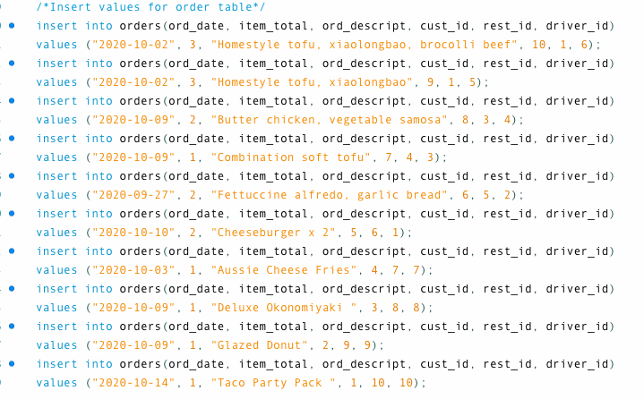

Slide 15
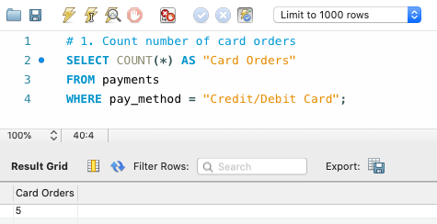
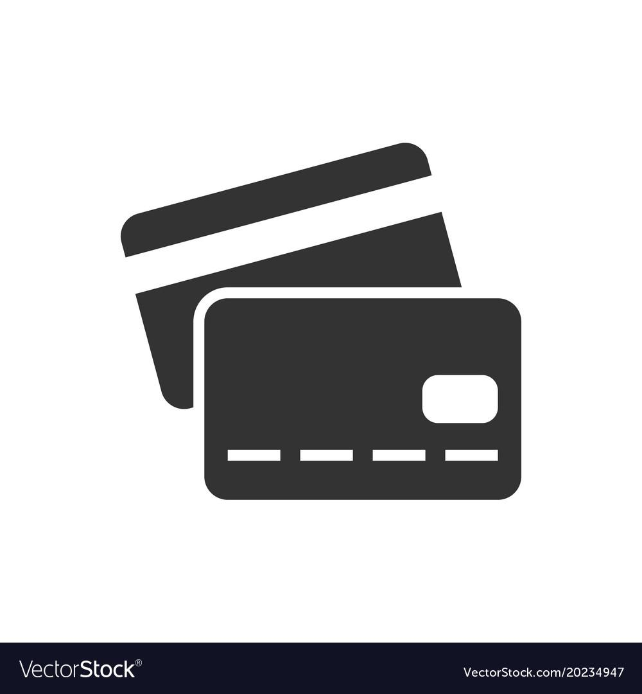
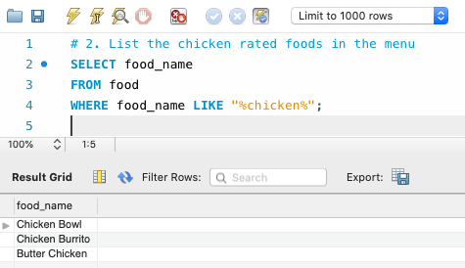

SQL Queries - Without Joins
How many credit/debit card orders were made in total?
What chicken related foods were available?
Notes:
Jessica

Slide 16
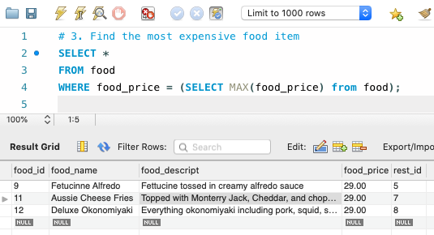

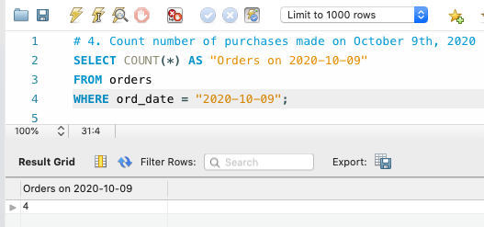

SQL Queries - Without Joins
What is the most expensive food item?
How many purchases were made on October 9th, 2020?
Notes:
Jessica

Slide 17
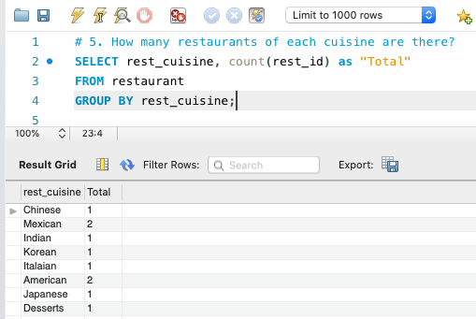

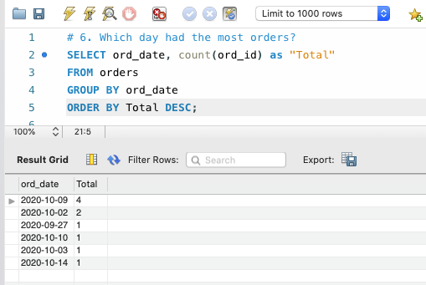

SQL Queries - Without Joins
How many restaurants of each cuisine are there?
Which day had the most orders?
Notes:
Jessica

Slide 18


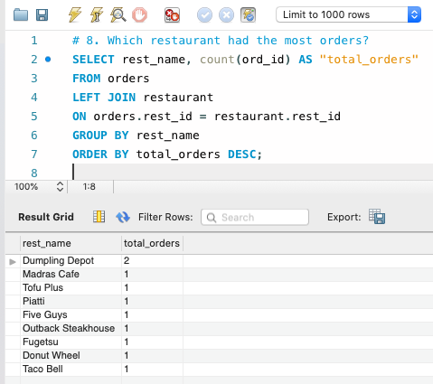
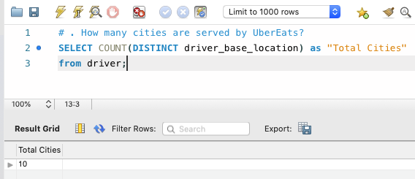
SQL Queries - Without Joins
With Joins
How many cities are served by UberEats?
Which restaurant had the most orders?
Notes:
Jessica

Slide 19
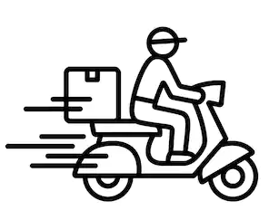

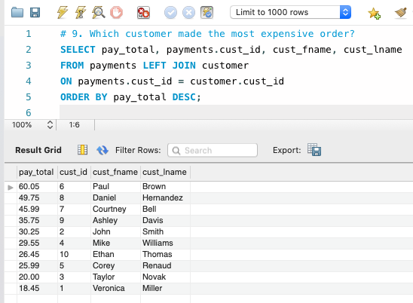
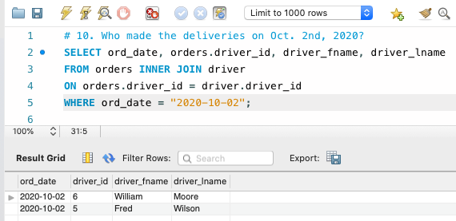
SQL Queries - With Joins
Who made the deliveries on Oct. 2nd, 2020?
Which customer made the most expensive order?
Notes:
Jessica

Slide 20
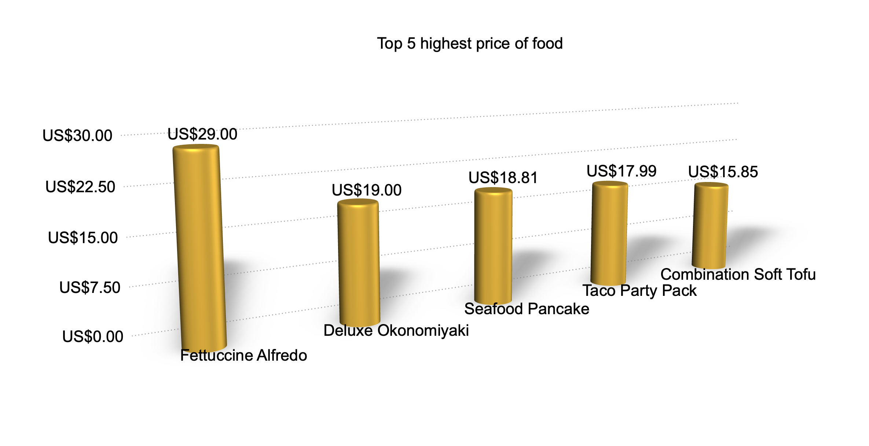
Visualization_food_price
Food_ID | Food_Name | Food_Description | Food_Price | Restaurant_ID
12 | Fettuccine Alfredo | Fettucine tossed in creamy alfredo sauce | US$29.00 | 5
15 | Deluxe Okonomiyaki | Everything okonomiyaki including pork, squid, shrimp, and scallops | US$19.00 | 8
11 | Seafood Pancake | Squid, clam, imitation crab, and grilled onions fried in batter | US$18.81 | 4
17 | Taco Party Pack | Choice of 12 tacos | US$17.99 | 10
10 | Combination Soft Tofu | Tofu boilled with beef, shrimp, and clams; served with rice | US$15.85 | 4
Notes:
Barry

Slide 21
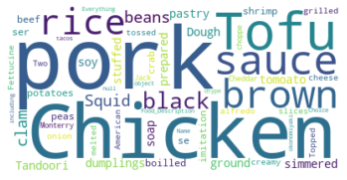
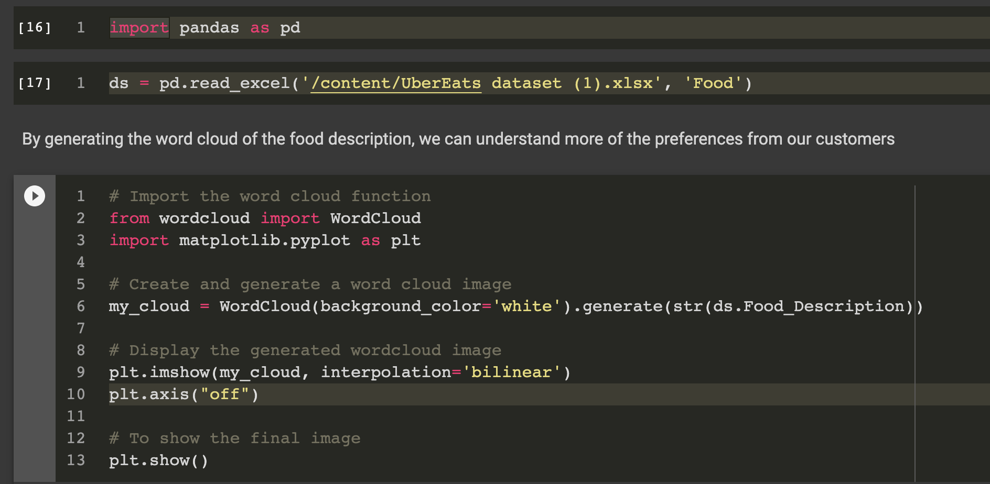
Visualization_Food_description

Slide 22
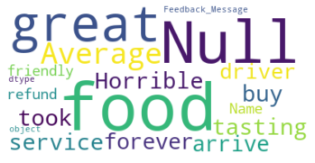
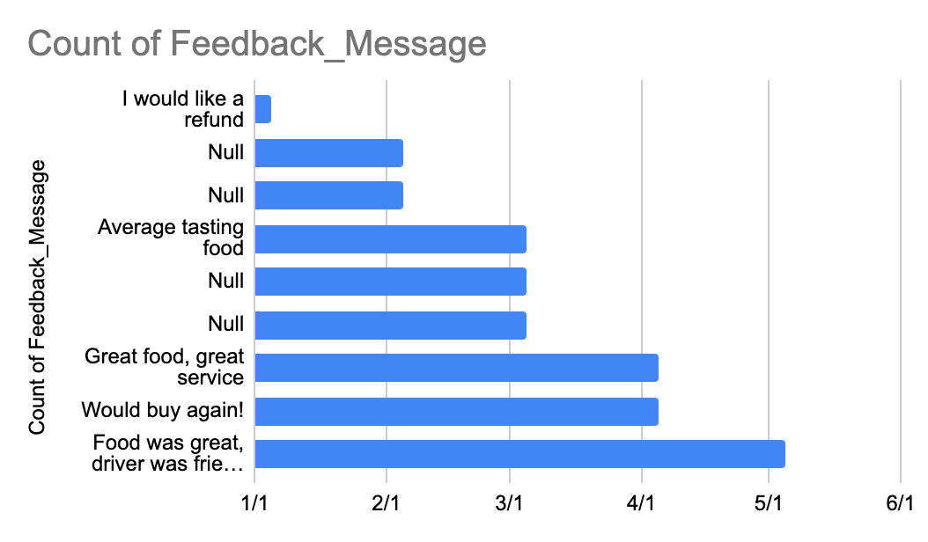
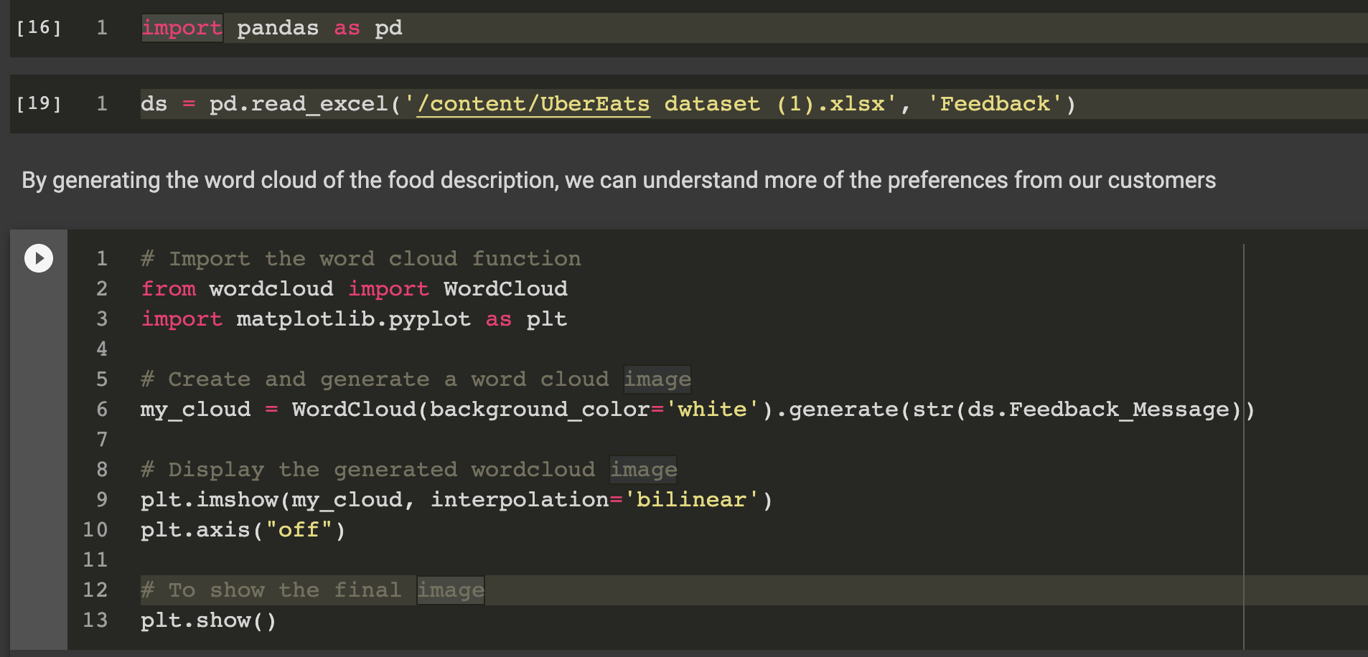
Visualization_Feedback_Message

Slide 23
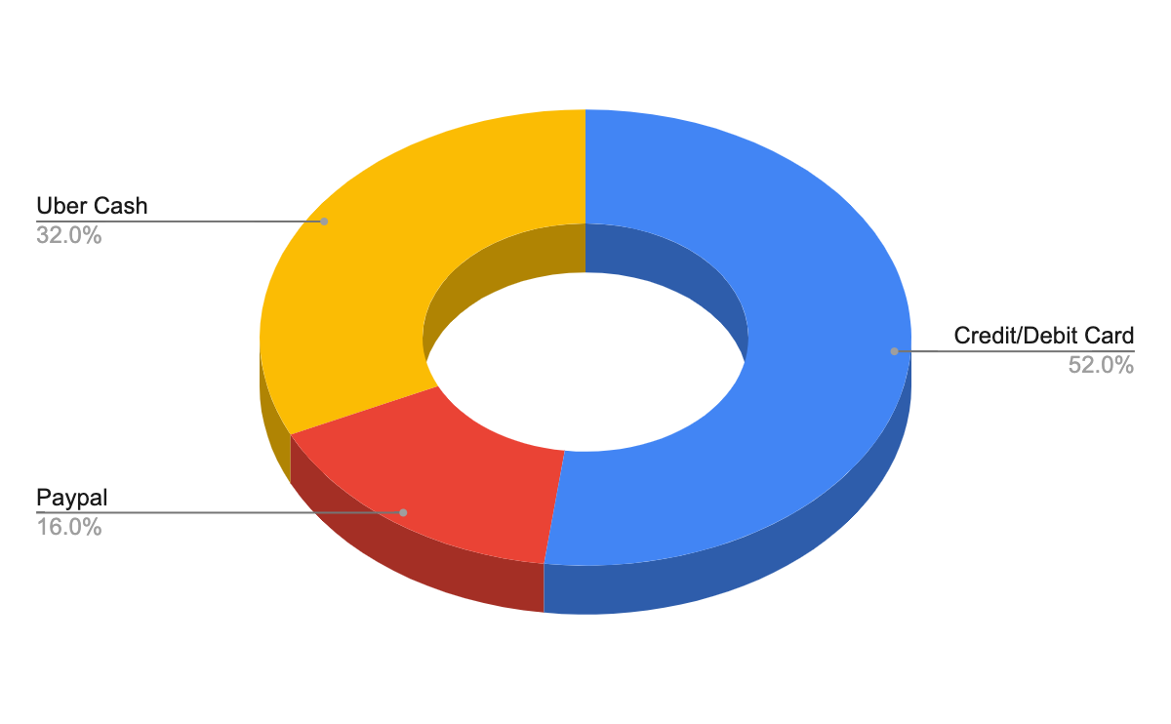
Visualization_Payment
Pay_id | Pay_date | Pay_method | Pay_total | Cust_id
1 | 2020/09/27 | Credit/Debit Card | 25.99 | 1
4 | 2020/10/03 | Credit/Debit Card | 30.25 | 4
5 | 2020/10/02 | Credit/Debit Card | 18.45 | 5
7 | 2020/10/09 | Credit/Debit Card | 35.75 | 7
8 | 2020/10/10 | Credit/Debit Card | 45.99 | 8
3 | 2020/10/02 | Paypal | 18.45 | 3
10 | 2020/10/14 | Paypal | 29.55 | 10
9 | 2020/10/09 | Uber Cash | 26.45 | 9
2 | 2020/10/9 | Uber Cash | 49.75 | 2
6 | 2020/10/9 | Uber Cash | 20 | 6

Slide 24
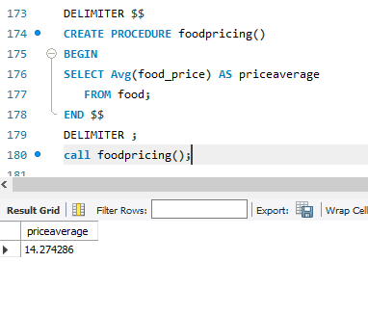


Stored Procedure and Subqueries
Stored Procedure
Using a stored procedure that returns the average food price.
DELIMITER $$
CREATE PROCEDURE foodpricing()
BEGIN
SELECT Avg(food_price) AS priceaverage
FROM food;
END $$
DELIMITER ;
call foodpricing();
Notes:
Shruti

Slide 25

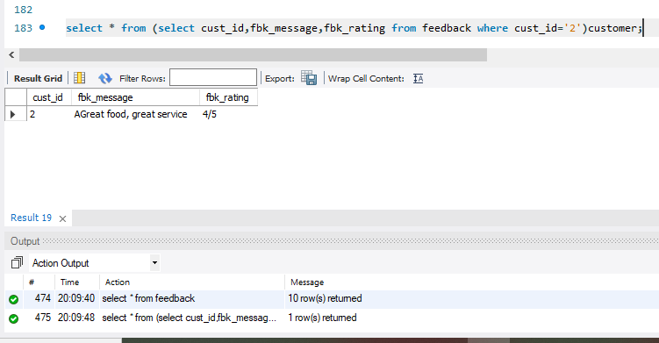
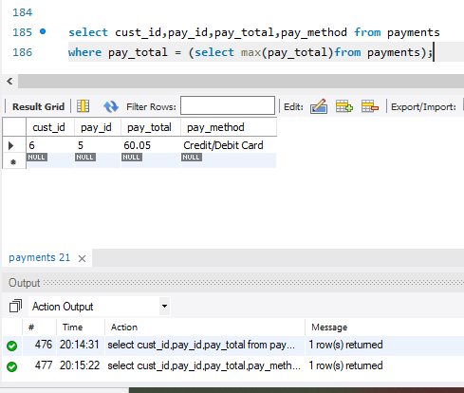
SubQueries
Using a Subquery, display the feedback message given by customer which has custid=2
select * from
(select cust_id,fbk_message,fbk_rating
from feedback where cust_id='2')customer;
Using Subquery returns the customer who has the maximum payment.
select cust_id,pay_id,pay_total,pay_method
from payments
where pay_total = (select max(pay_total)
from payments);
Notes:
Shruti

Slide 26



Conclusion
In our project we have three simple steps – browse, order, and track; then you are ready to go
Browse
Order
Track
Customers simply place an order and make sure the address is correct and pay for the order. After placing the order, the customer verifies their address, estimated delivery time and the price
When someone orders from a restaurant through Uber Eats, restaurants simply need to prepare the food for delivery, and an UberEats driver will deliver the food to the customer.
The whole process allows the customer to track everything. And once the food is delivered it sends push notifications to the customer about their experience about the order placement and delivery.

Slide 27
Conclusion & Learning
This Project helps us to understand user's empathy and connect with the real-world scenarios. We have used the following concepts of SQL:
Table Creation: Customer, Food, Restaurant, Order, Driver, Payments and Feedback.
Swim Lane Diagram: to understand the customer journey maps.
ER Diagram: to understand the relationship between the tables.
SQL JOINS, Subqueries and Stored Procedures: to understand the advanced SQL concepts.

Slide 28
Thank You!

